Slide 1
Secure data hiding in image using steganography
CAPSTONE PROJECT
Presented By: ALISHA CHAUDHARY
Student Name : ALISHA CHAUDHARY
College Name & Department : GURU TEGH BAHADUR INSTITUTE OF TECHNOLOGY
BTECH CSE-AIML

Slide 2
OUTLINE
Problem Statement
Technology used
Wow factor
End users
Result
Conclusion
Git-hub Link
Future scope

Slide 3
Problem Statement
With the rise of digital communication, securing sensitive information has become a major challenge. Traditional encryption methods often attract attention, making the data vulnerable to interception. To address this, we explore a method to hide confidential messages within digital images. The goal is to embed secret data in an image without altering its visible appearance, ensuring secure and undetectable communication.

Slide 4
Technology used
Platform: The project is implemented using Python, ensuring cross-platform compatibility.
Libraries:
OpenCV: To perform advanced image operations and handle image I/O.
Os Library:To interact with the operating system.
String library: To take input as string.
Cryptography: To securely encrypt and decrypt the secret message embedded within the image.

Slide 5
Wow factors
This project really stands out because it uses a clever double layer of security. First, it hides your secret message inside an image so that everything looks completely normal to the naked eye. Then, it encrypts the message, which means that even if someone finds it, they won't be able to read it without the right key.We built the project in Python using popular libraries like OS,String, OpenCV, and Cryptography, which makes it both powerful and easy to work with on any operating system. Plus, the design leaves plenty of room for future improvements, whether it's enhancing its resistance to detection or adapting it for different types of media.

Slide 6
End users
The end users for this project are anyone who needs to keep their communications secure and under the radar. For example:
Security Professionals and Researchers: They can use this tool to test and develop more secure communication methods.
Government Agencies: These organizations can employ the technique to safeguard classified or sensitive information.
Businesses: Companies that need to protect trade secrets or confidential data may find this method especially useful.
Journalists and Activists: In scenarios where privacy is critical, this approach can help ensure that important messages remain hidden from prying eyes.

Slide 7

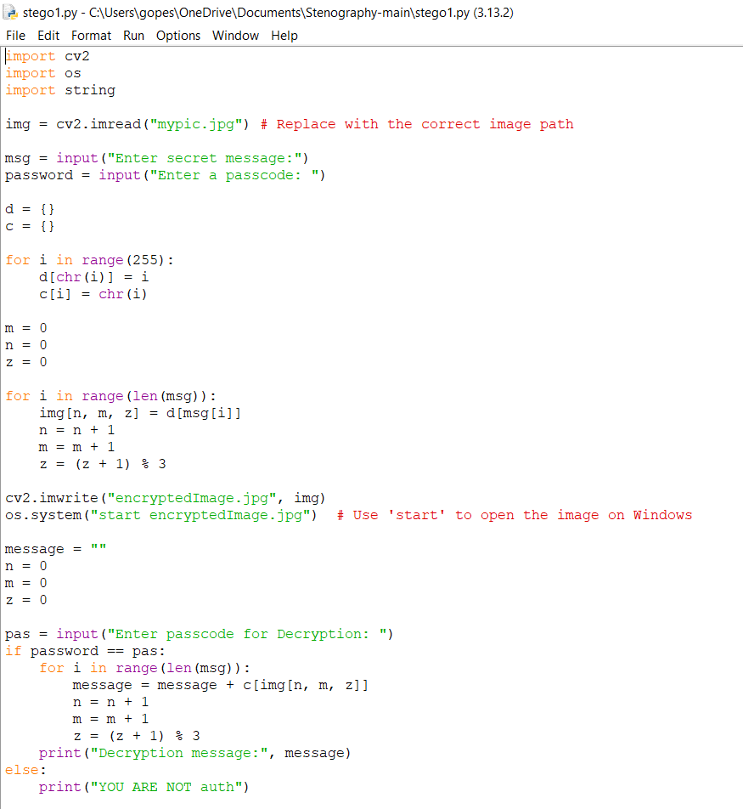
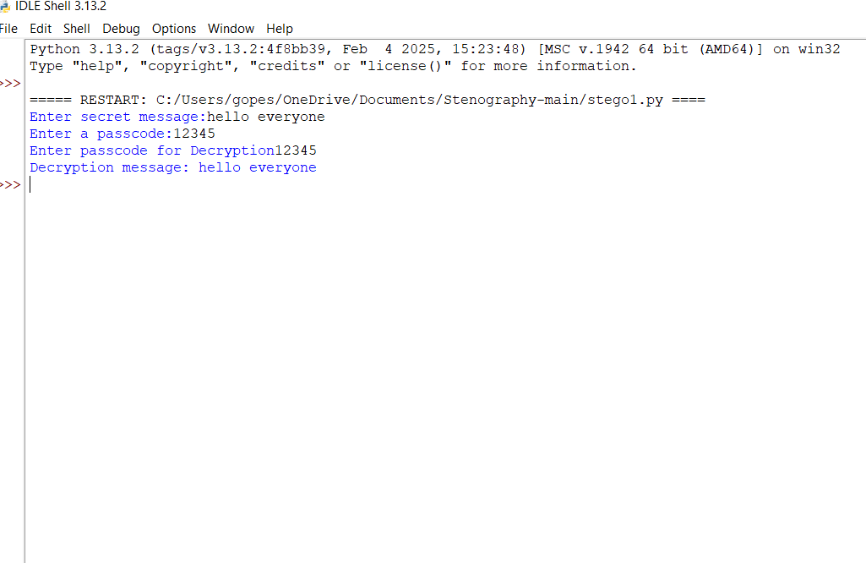
Results

Slide 8
Conclusion
In the end, this project demonstrates an effective way to secure communication by hiding a secret message within an image. Here’s how I did it:
1. Encryption: I began by encrypting the secret message, ensuring that even if someone discovered it, They wouldn’t be able to understand it without the correct decryption key.I provided a secret message and the the secret pass code to access it.
2. Steganography: Next, I embedded this encrypted text into a standard image using steganographic techniques. This step was crucial because it allowed the image to remain visually unchanged, making the hidden data nearly impossible to detect.
3. Decryption: Finally, I implemented a decryption process that, when provided with the right key, extracts and deciphers the hidden message from the image.I entered the correct passcode and then obtained the secret message.

Slide 9
GitHub Link
https://github.com/Alisha19100/project_aicte.git

Slide 10
Future scope(optional)
We're looking into ways to make the process even more secure and to support additional media types.

Slide 11
THANK YOU

